Slide 1
Fundamentals of Analytical chemistry (221)
CHAPTER-3
Manufacture of Inorganic Acids (Hydrochloric, Hydrofluoric& Sulfuric acids)

Slide 2
Cont’.....
Introduction
Hydrochloric, Hydrofluoric & Sulfuric acids are some of the important inorganic acids that are widely used in industry and laboratory.
In this chapter we are going to discuss about :
the use of,
method of preparation and
properties of Hydrochloric, Hydrofluoric & Sulfuric acids.
Methods of manufacture of hydrochloric acid and its uses
Hydrochloric acid is a monoprotic acid.
In aqueous hydrochloric acid, the H⁺ joins a water molecule to form a hydronium ion, H₃O⁺. Which means it can dissociate
HCl + H₂O → H₃O⁺ + Cl⁻

Slide 3
Cont’.....
The other ion formed is Cl⁻, the chloride ion.
Hydrochloric acid can therefore be used to prepare salts called chlorides, such as NaCl.
HCl is a strong acid; it is essentially completely dissociated in water. HCl is the preferred acid in titration for determining the amount of bases.
Concentrated hydrochloric acid dissolves many metals and forms oxidized metal chlorides and hydrogen gas,

Slide 4
Preparation of HCl
The following methods are used for the preparation of HCl and each method involves two stages.
Production of HCl gas
Absorption of HCl in water
Methods of production
Chlorination of aliphatic and aromatic hydrocarbons,
HCl is the by-product
CH₄ + Cl₂ + hv → CH₃Cl + HCl
C₆H₆ + Cl₂ + hv → C₆H₅Cl + HCl
2. Sulphate method; this method is based on the reaction of sodium chloride with sulphuric acid.

Slide 5
Cont’.....
NaCl + H₂SO₄ → HCl + NaHSO₄
NaCl + NaHSO₄→ HCl + Na₂SO₄
The net reaction is: 2NaCl + H₂SO₄ → Na₂SO₄ + 2HCl
This reaction is carried out at 500-550⁰C. The yield is 39-40% by weight.
3. Direct synthesis
Hydrogen burns in chlorine exothermically.
H₂ + Cl₂ → 2HCl
Industrially the above reaction is carried out by burning H₂ in Cl₂ at 2300⁰C-2400⁰C.
The gas leaving the furnace contains 80-90% of HCl

Slide 6
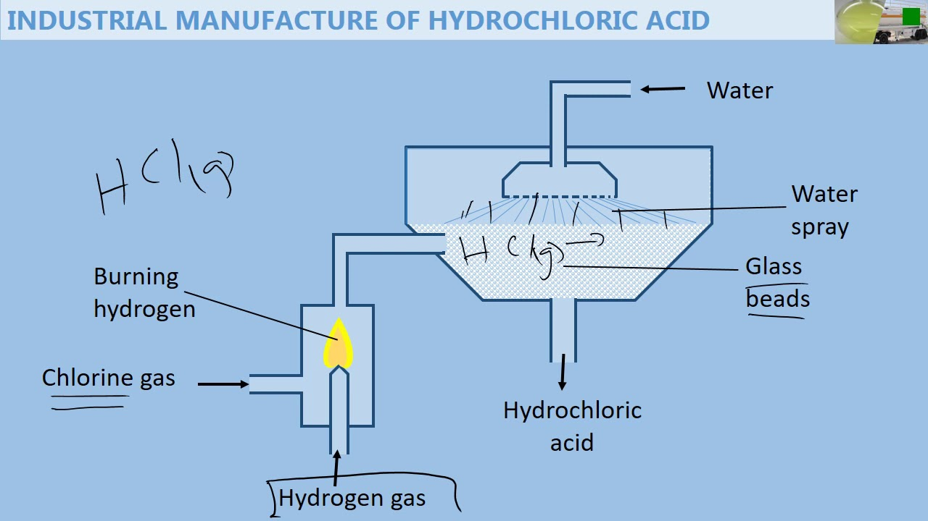
Cont’.....

Slide 7
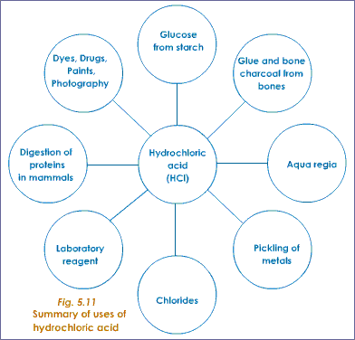
Cont’.....
Uses of HCl

Slide 8
Cont’.....
One of the most important applications of HCl is in the pickling of steel, to remove rust or iron oxide scale from iron or steel before subsequent processing, such as extrusion, rolling, galvanizing, and other techniques.
Technical quality of HCl at typically 18% concentration is the most commonly used pickling agent for the pickling of carbon steel grades.
Fe₂O₃ + Fe + 6HCl→ 3FeCl₂ + 3 H₂O
Another major use of HCl is in the production of organic compounds, such as vinyl chloride and dichloroethane for PVC.
2CH₂=CH₂ + 4HCl +O₂→2ClCH₂CH₂Cl + 2H₂O
(dichloromethane by oxychlorination)
Wood + HCl + heat → Activated carbon
Numerous products can be produced with hydrochloric acid in normal acid-base reactions, resulting in inorganic compounds.

Slide 9
Cont’.....
Industrial manufacture of hydrofluoric acid and its uses
Hydrofluoric acid (HF) is a solution of hydrogen fluoride in water.
While it is extremely corrosive and difficult to handle, in the technical sense, it is a weak acid.
Hydrogen fluoride, often in the aqueous form as hydrofluoric acid, is a valued source of fluorine.
diverse polymers such as polytetrafluoroethylene(Teflon), and
most other synthetic materials that contain fluorine.
Hydrofluoric acid is the best known to the public for its ability to dissolve glass by reacting with SiO₂
The major component of most glass, to form silicon tetra fluoride gas and hexafluoro silicic acid.

Slide 10
Cont’.....
Because of its high reactivity toward glass, hydrofluoric acid must be stored (in small quantities) in polyethylene or Teflon containers.
It is also unique in its ability to dissolve many metal and semimetal oxides.
Due to its low degree of ionization in dilute solution, hydrofluoric acid is the only hydrohalic acid that is not considered as strong acid.
Industrial manufacture of hydrofluoric acid
In industry, hydrofluoric acid is produced by treatment of the mineral fluorite (CaF₂) with concentrated sulfuric acid.
When combined at 250ºC, these two substances react to produce hydrogen fluoride and calcium sulfate according to the following chemical equation:

Slide 11
Cont’.....
CaF₂ + H₂SO₄ → 2 HF + CaSO₄
Most HF is produced as a by-product of the production of phosphoric acid, which is derived from the mineral apatite(phosphate mineral) with the formula Ca₅(PO₄)₃F).
Use of HF
Hydrofluoric acid (HF) has various uses.
It is used as a catalyst in oil refining
It is used in the production of organofluorine compounds e.g., many organofluorine compounds are prepared using HF as the fluorine source, including Teflon[(C₂F₄)n], fluoropolymers, fluorocarbons, and refrigerants such as Freon(CCl₂F₂).

Slide 12
Cont’.....
It is used for production of fluorides.
Many high volume inorganic fluoride compounds are prepared from hydrofluoric acid.
For example: cryolite(Na₃AlF₆) , AlF₃ and etc
It removes oxide impurities from stainless steel, a process called pickling (of preserving food), and silicon wafers in the semiconductor industry.

Slide 13
Cont’.....
Chamber process and contact process of manufacture of sulphuric acid & its handling
Sulfuric (or sulphuric) acid, H₂SO₄ is a strong mineral acid.
It is soluble in water at all concentrations.
it is a clear, colorless, odorless, viscous liquid that is very corrosive.
Sulfuric acid is very stable oxyacid's of sulfur.
It is often called king of chemicals, since it is one of the most useful chemicals which is extensively used in industries.
Sulfuric acid has many applications, and is one of the top products of the chemical industry.
Principal uses include ore processing, fertilizer manufacturing, oil refining, wastewater processing, and synthesis.

Slide 14
Cont’.....
Manufacturing of sulfuric acids
There are two general methods of manufacturing of sulfuric acid.
These are Lead chamber process and contact process.
i) Manufacture of H₂SO₄ by Lead Chamber process
Lead chamber process: In the original lead chamber process, sulfur and potassium nitrate are ignited in a room lined with lead foil
Potassium nitrate, or saltpeter is an oxidizing agent oxidizes the sulfur to sulfur trioxide according to the reaction:
6KNO₃(s) + 7S(s) →3K₂S(s) + 6NO (g) +4SO₃ (g)
When the sulfur trioxide reacted with the water, sulfuric acid was produced:
SO₃ (g) + H₂O (l) →H₂SO₄ (aq)

Slide 15
Cont’.....
This process is a batch process and can be formed in the consumption of potassium nitrate.
ii) Manufacture of H₂SO₄ by double adsorption contact process
Sulfuric acid is produced from sulfur, oxygen and water via the contact process.
In the first step, sulfur is burned to produce sulfur dioxide
S(s) + O₂(g) → SO₂(g)
This is then oxidized to sulfur trioxide using oxygen in the presence of a vanadium (V) oxide catalyst.
(2) 2 SO₂ + O₂(g) → 2 SO₃(g) (in presence of V₂O₅)

Slide 16
Cont’.....
For example: In our country, in Awash Melkasa H₂SO₄ ,there are four converters or beds that are used for conversion of SO₂ to SO₃ by using V₂O₅ catalyst
In 1st bed, 63% SO₂ is changed to SO₃, in second bed 87% SO₂ is changed to SO₃, in third bed 96% SO₂ is changed to SO₃ and finally in the fourth bed 98.5% SO₂ is changed to SO₃.
Finally, the sulfur trioxide is treated with water (usually as 97-98% H₂SO₄ containing 2-3% water) to produce 98-99% sulfuric acid.
(3) SO₃(g) + H₂O(l) → H₂SO₄(l)
Note that directly dissolving SO₃ in water is impractical due to the highly exothermic nature of the reaction, forming a corrosive mist instead of a liquid.

Slide 17
Cont’.....
Alternatively, SO₃ can be absorbed into H₂SO₄ to produce oleum (H₂S₂O₇), which may then be mixed with water to form sulfuric acid.
(3) H₂SO₄(l) + SO₃ → H₂S₂O₇(l)
Oleum is reacted with water to form concentrated H₂SO₄.
(4) H₂S₂O₇(l) + H₂O(l) → 2 H₂SO₄(l)
Today, nearly all of the world’s sulfuric acid is produced by using this method.
Physical properties of H₂SO₄
Forms of sulfuric acid
Although nearly 100% sulfuric acid can be made, this loses SO₃ at the boiling point to produce 98.3% acid.

Slide 18
Cont’.....
The 98% grade is more stable in storage, and is the usual form of what is described as concentrated sulfuric acid.
Other concentrations are used for different purposes.
Some common concentrations are:
10%, dilute sulfuric acid for laboratory use,
33.5%, battery acid (used in lead-acid batteries),
62.18%, chamber or fertilizer acid,
77.67%, tower or Glover acid,
98%, concentrated acid

Slide 19
Cont’.....
Chemical properties H₂SO₄
Reaction with water
The hydration reaction of sulfuric acid is highly exothermic.
If water is added to the concentrated sulfuric acid, it can boil and spit dangerously.
One should always add the acid to the water rather than the water to the acid.
This can be remembered through such as: Add Acid", or "Drop acid, not water", or "Acid to water, " or "Put the king into the water, not the water into the king" .

Slide 20
Cont’.....
The necessity for this safety precaution is due to the relative densities of these two liquids.
Water is less dense than sulfuric acid, meaning water will tend to float on top of this acid.
Environmental aspects
Sulfuric acid is a constituent of acid rain, which is formed by atmospheric oxidation of sulfur dioxide in the presence of water - i.e. oxidation of sulfurous acid.
Sulfur dioxide is the main by product produced when sulfur-containing fuels such as coal or oil are burned.

Slide 21
Cont’.....
Sulfuric acid is a very important commodity chemical, and indeed, a nation's sulfuric acid production is a good indicator of its industrial strength.
The major use (60% of total production worldwide) for sulfuric acid is in the "wet method" for the production of phosphoric acid, used for manufacture of phosphate fertilizers as well as trisodium phosphate for detergents.
The overall process can be represented as:
Ca₅F(PO₄)₃ + 5 H₂SO₄ + 10 H₂O → 5 CaSO₄•2 H₂O + HF + 3 H₃PO₄

Slide 22
Cont’.....
Sulfuric acid is used in large quantities by the iron and steel making industry to remove oxidation, rust and scale from rolled sheet and billets prior to sale to the automobile and white-goods industry.
Another important use for sulfuric acid is for the manufacture of aluminum sulfate, also known as paper maker's alum.
This can react with small amounts of soap on paper pulp fibers to give gelatinous aluminum carboxylates, which help to coagulate the pulp fibers into a hard paper surface.
It is also used for making aluminum hydroxide, which is used at water treatment plants to filter out impurities, as well as to improve the taste of the water.

Slide 23
Cont’.....
Aluminum sulfate is made by reacting bauxite with sulfuric acid:
Al₂O₃ + 3 H₂SO₄ → Al₂ (SO₄)₃ + 3 H₂O
Sulfuric acid is used for a variety of other purposes in the chemical industry.
For example, it is the usual acid catalyst for the conversion of cyclohexanoneoxime to caprolactam, used for making nylon.
Sulfuric acid is also important in the manufacture of dyestuffs solutions and is the "acid" in lead-acid (car) batteries.
Sulfuric acid is also used as a general dehydrating agent in its concentrated form.
Therefore, safety is needed in order to minimize Laboratory and Industrial hazardous.

